Slide 1
^{Chapter 2} Abstract Data Types
ZAMAN UNIVERSITY
Data Structures and Algorithms

Slide 2
Outline
Stacks
Queues and Priority Queues
Linked Lists
Abstract Data Types
Specialized Lists

Slide 3
Outline
Stacks
Queues and Priority Queues
Linked Lists
Abstract Data Types
Specialized Lists

Slide 4
Linked Lists
In an unordered array, searching is slow, whereas in an ordered array, insertion is slow. In the both kinds, deletion is slow
Also, the size of array cannot be changed after it is created
The Linked List solves some of these problems
Linked Lists are probably the second most commonly used general-purpose storage structures after array

Slide 5
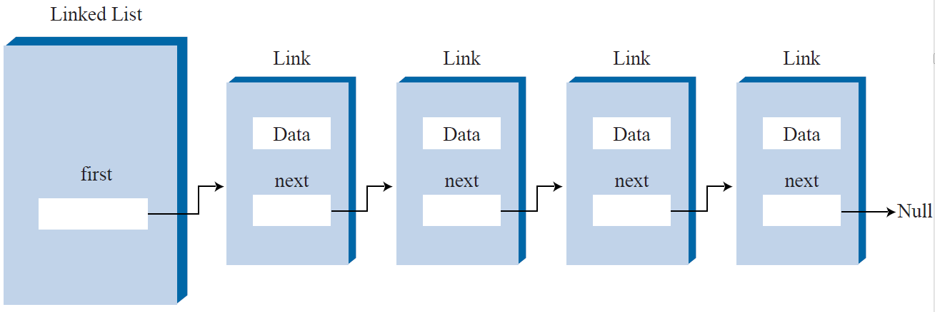
Understanding Links
In a linked list, each data item is embedded in a link
A link is an object of a class called something like Link
Because there are many similar links in a list, it makes sense to use a separate class for them, distinct from the linked list itself
Each link object contains a pointer (which we’ll call pNext) to the next link in the list.
class Link
{ public:
int iData; //data
double dData; //data
Link* pNext; //pointer to next link
};

Slide 6
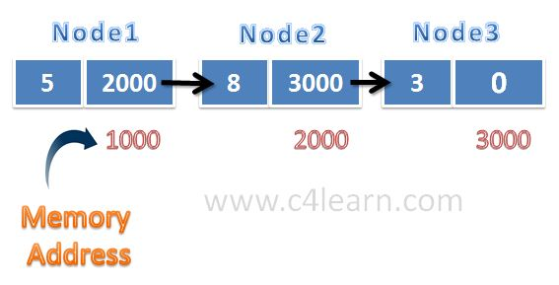
Linked Lists: Structure Defined by Relationship, Not Position
In an array each item can be directly accessed using an index number
In a list the only way to find a particular element is to follow along the chain of links
You can’t access a data item directly; you must use relationships between the items to locate it
You start with the first item, go to the second, and then the third, and so on, until you find what you’re looking for.

Slide 7
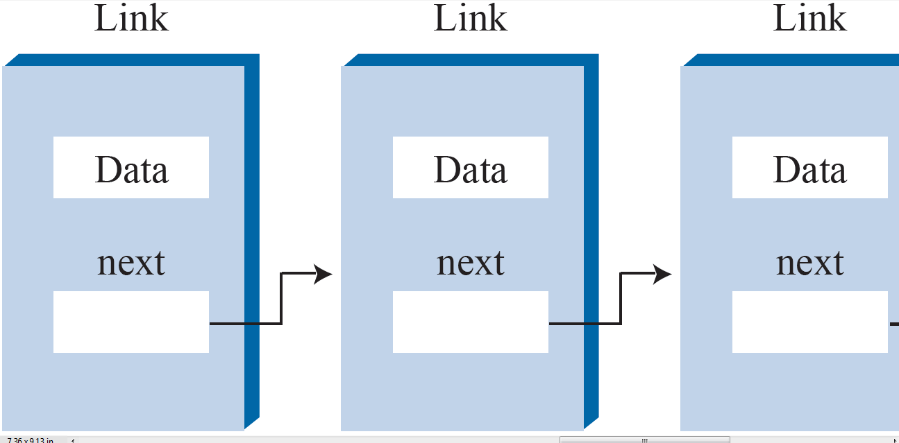
Create A Link in C++
class Link{
public:
int iData; //Data Item
string sName; //Data Item
Link* pNext; //Pointer to the next link in list
void InitLink(int id, string sn); //Initiation Function to class attributes
void DisplayLink(); //Display value of Items
};
void Link::InitLink (int id, string sn){
iData = id;
sName = sn;
pNext = NULL;
};
void Link::DisplayLink(){
cout << " {iData: " << iData;
cout << " sName: " << sName << "}" << endl;
};

Slide 8
Create A Linked List in C++
class LinkList{
Link* pFirst; //ptr to first link on list
public:
void InitLinkList();
bool IsEmpty();
void InsertFirst(int d, string s);
void RemoveFirst();
void DeleteLinkList();
//... Other Methods here
};
void LinkList::InitLinkList(){
pFirst = NULL; //(no links on list yet)
};
bool LinkList::IsEmpty(){
if(pFirst == NULL ) return true;
else return false;
};

Slide 9
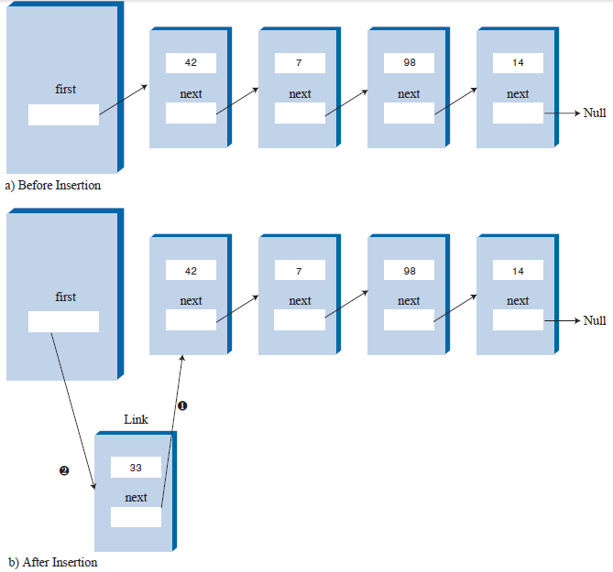
The InsertFirst() Function Member
void LinkList::InsertFirst(int i, string s){
Link* NewLink = new Link(); //make new link
NewLink->InitLink(i, s);
NewLink->pNext = pFirst; //newLink-->old first
pFirst = NewLink; //first-->newLink
};

Slide 10
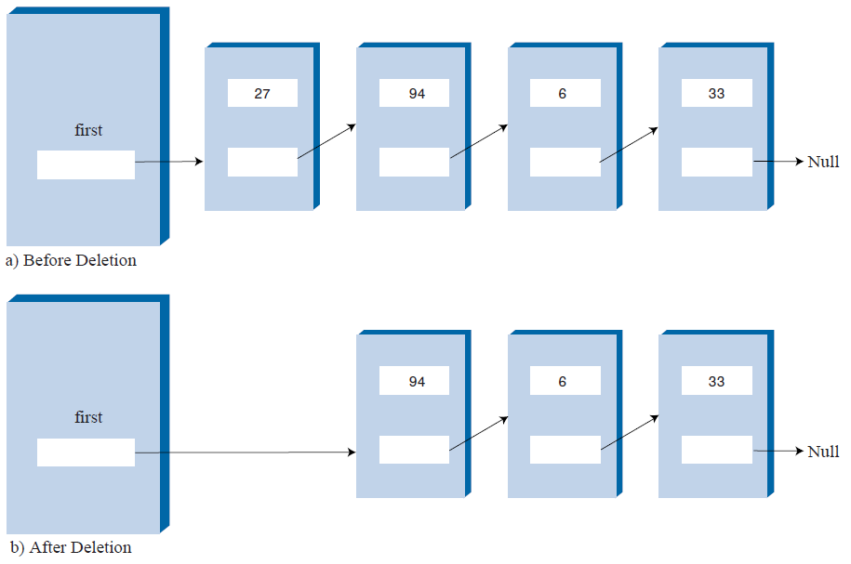
The RemoveFirst() Member Function
void removeFirst() //delete first link
{ //(assumes list not empty)
Link* pTemp = pFirst; //save first
pFirst = pFirst->pNext; //unlink it: first-->old next
delete pTemp; //delete old first
}

Slide 11
Delete LinkList (Clear LinkList from Memory)
void DeleteLinkList() {
Link* pCurrent = pFirst; //start at beginning of list
while(pCurrent != NULL) { //until end of list,
Link* pOldCur = pCurrent; //save current link
pCurrent = pCurrent->pNext; //move to next link
delete pOldCur; //delete old current
}
}

Slide 12

Create the following function members:
1. void Size() – return number item/link in the list;
2. void InsertToPosition(int intData, string strData,
int pos) – Create a new link with these values: i & s. In case pos is in the range thus insert the new link to the position;
2. void InsertTail(int i, string s) – insert a link with value i and s to tail of the list;
3. void RemoveTail() – remove a link from the list;
4. Link* GetTail() – return a link at tail of the list;
5. Link* FirstTailFirstLink() – return the first link or head link;
6. Link* Find(int data) – return a link with a value iData equal to data;
Read book of Robert Lafore, page: 146– 165 for next lecture

Slide 13
To be continued…

